Slide 1
Jefferson Lab Overview
Deb Magaldi
Public Affairs
magaldi@jlab.org

Slide 2
Background
History
In 1985, a university consortium led by three Virginia schools (University of Virginia, College of William&Mary & Virginia State) won the contract to locate CEBAF (now Jefferson Lab) in Virginia.
Federal government provided $600 Million to build JLab.
What does JLab “do?”
Basic Research: Experimental and theoretical nuclear physics
Superconducting accelerator technology
Applied Research/Tech. Transfer: Free-electron lasers for defense, materials, nanotechnology and bioscience; medical imaging

Slide 3
The Mission of Nuclear Physics is to understand the origin, development and structure of visible matter in the universe – the matter that makes up stars, planets and everything in our world.
Jefferson Lab is a $600M Department of Energy facility for nuclear physics research to explain the quark structure of matter and the forces that hold the nucleus together. Managed by Jefferson Science Associates (JSA) under a performance-based contract, Jefferson Lab was constructed within cost and on schedule and is currently performing above its design specifications.
The heart of Jefferson Lab is its 6 GeV (billion electron volt) electron accelerator delivering beams of unprecedented quality to 3 simultaneous halls.
Scientific purpose of Jefferson Lab
Jefferson Lab acts as a microscope to allow us to look into the inner structure of the nucleus. The purpose of the research done at Jefferson Lab is to help us understand how quarks and gluons make up the nucleus and the forces that hold matter together.

Slide 4
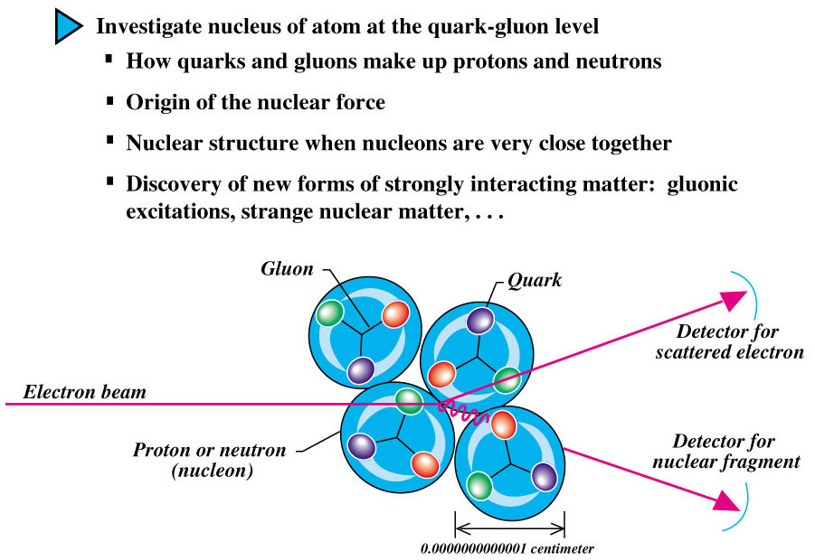

Slide 5
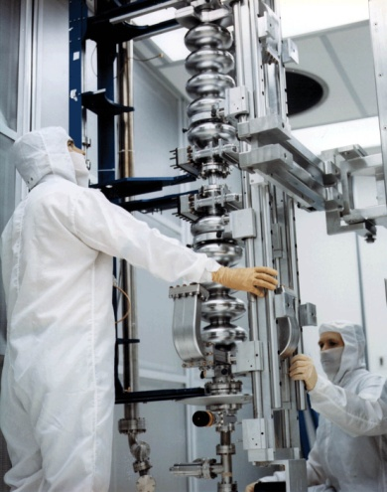
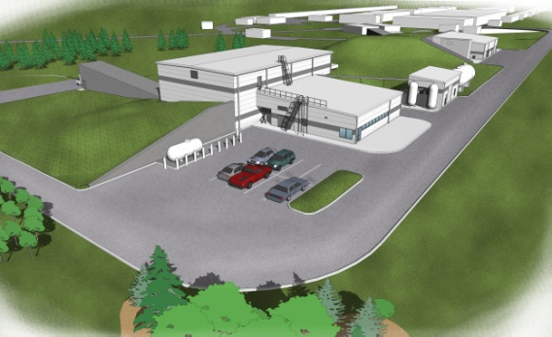
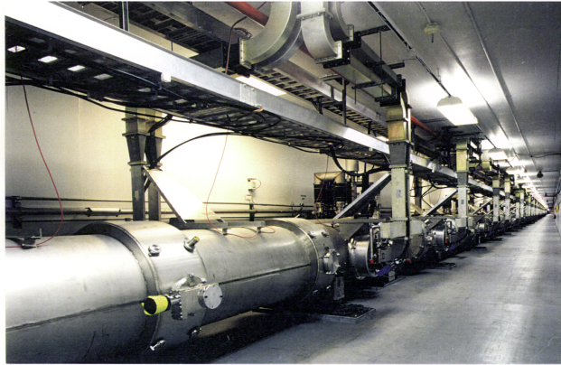
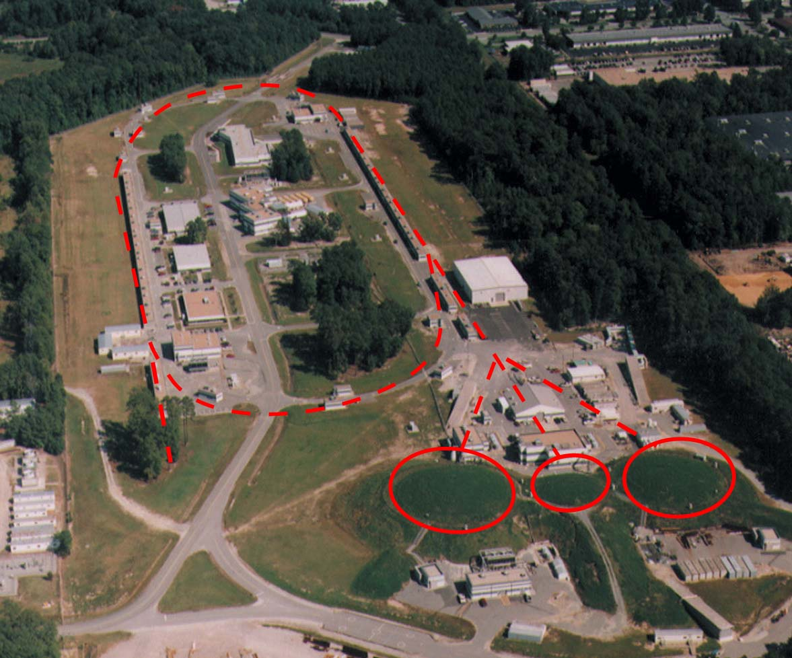
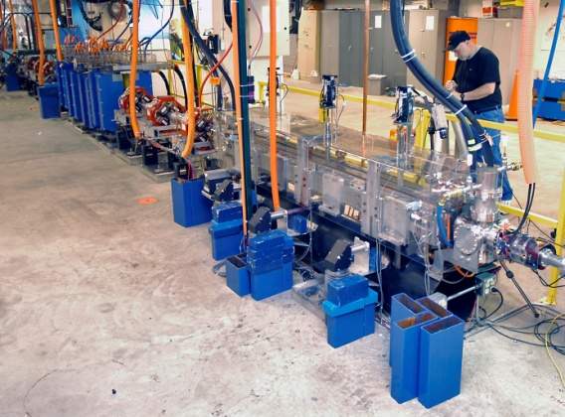
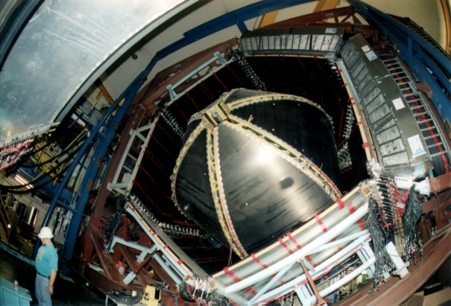
Unique Forefront Capabilities for Science
Cryomodules in the accelerator tunnel
Superconducting radiofrequency (SRF) cavities undergo vertical testing.
Artist concept of the new Hall D
Free-Electron Laser Wiggler inside FEL accelerator
A
B
C
CEBAF Large Acceptance Spectrometer (CLAS) in Hall B
An aerial view of the recirculating linear accelerator and 3 experimental halls.

Slide 6
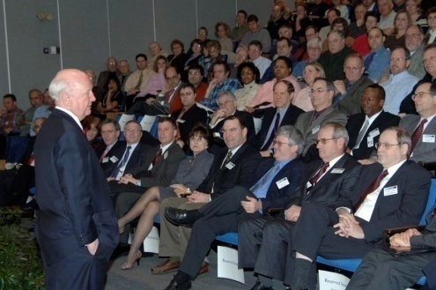
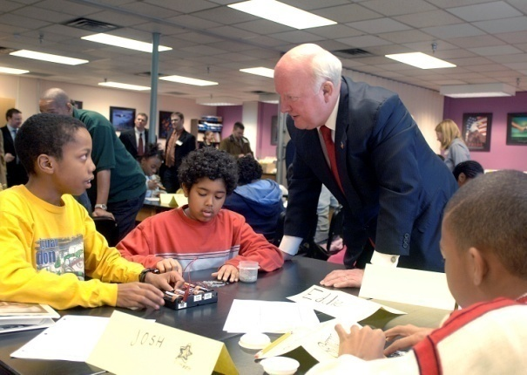
Snapshot
Statistics
$100M annual budget
650 employees and 100 subcontractors
$53M annual payroll
Average salary over $75K/year
58% with B.S. degree or higher, 21% Ph.D.s
1,300 active researchers from about 200 institutions (35 states and 30 countries)
15 Virginia universities participate, with four of the 10 most active user groups from Virginia (UVA, W&M, ODU, Hampton University)
Department of Energy Secretary Samuel Bodman announces DOE approval of JLab 12 GeV Upgrade and interacts with students in the BEAMS program during a visit to Jefferson Lab.

Slide 7
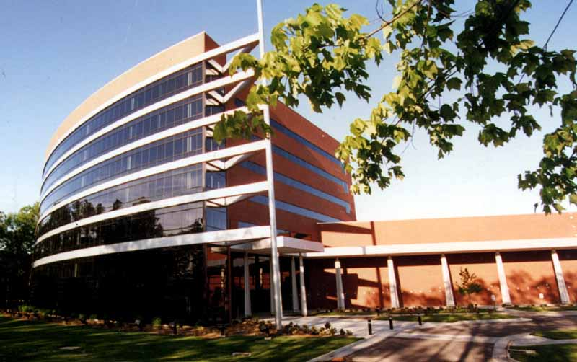
Snapshot
Results
Nearly 1/3 of all Ph.D.s awarded in the U.S. in Nuclear Physics are based on JLab research
More than 200 visiting scientists work at the Lab daily
More than 150 nuclear physics experiments have been completely run using CEBAF.
The Applied Research Center, built by the City of Newport News, serves as an incubator for JLab-related technologies.

Slide 8
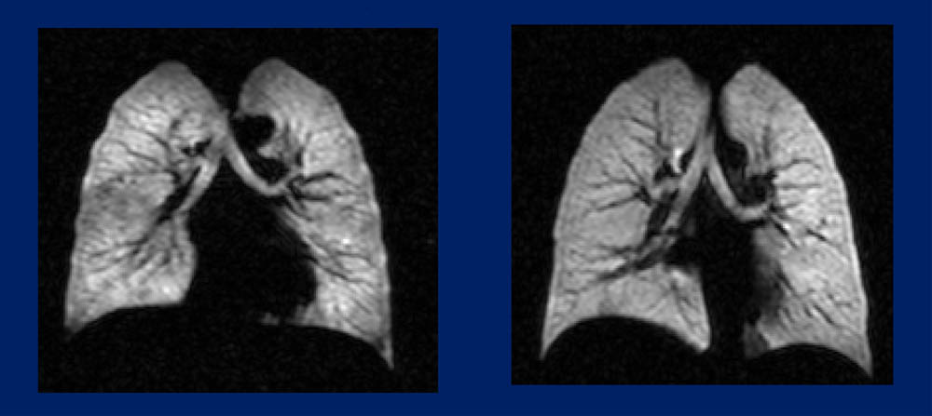
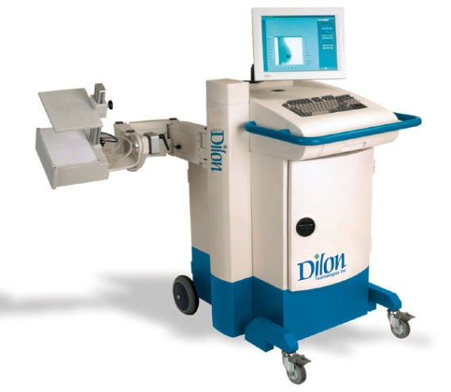
Snapshot
High resolution image of lungs made possible by Nuclear Physics target technology.
Applications/Spinoffs
World class medical imaging effort with applications for breast cancer detection, prostate imaging, live small animal imaging for biological research, and high resolution lung imaging (Ex: Identification of cystic fibrosis gene)
More than 80 patents awarded to JLab staff
        Free Electron Laser recognized by 2005 R&D 100 Award
- Other: Defense, Materials, Nanotechnology, Bioscience
Dilon Technologies, a start-up company, is producing new type of mammography camera featured on ABC Evening News (October 23, 2006)

Slide 9
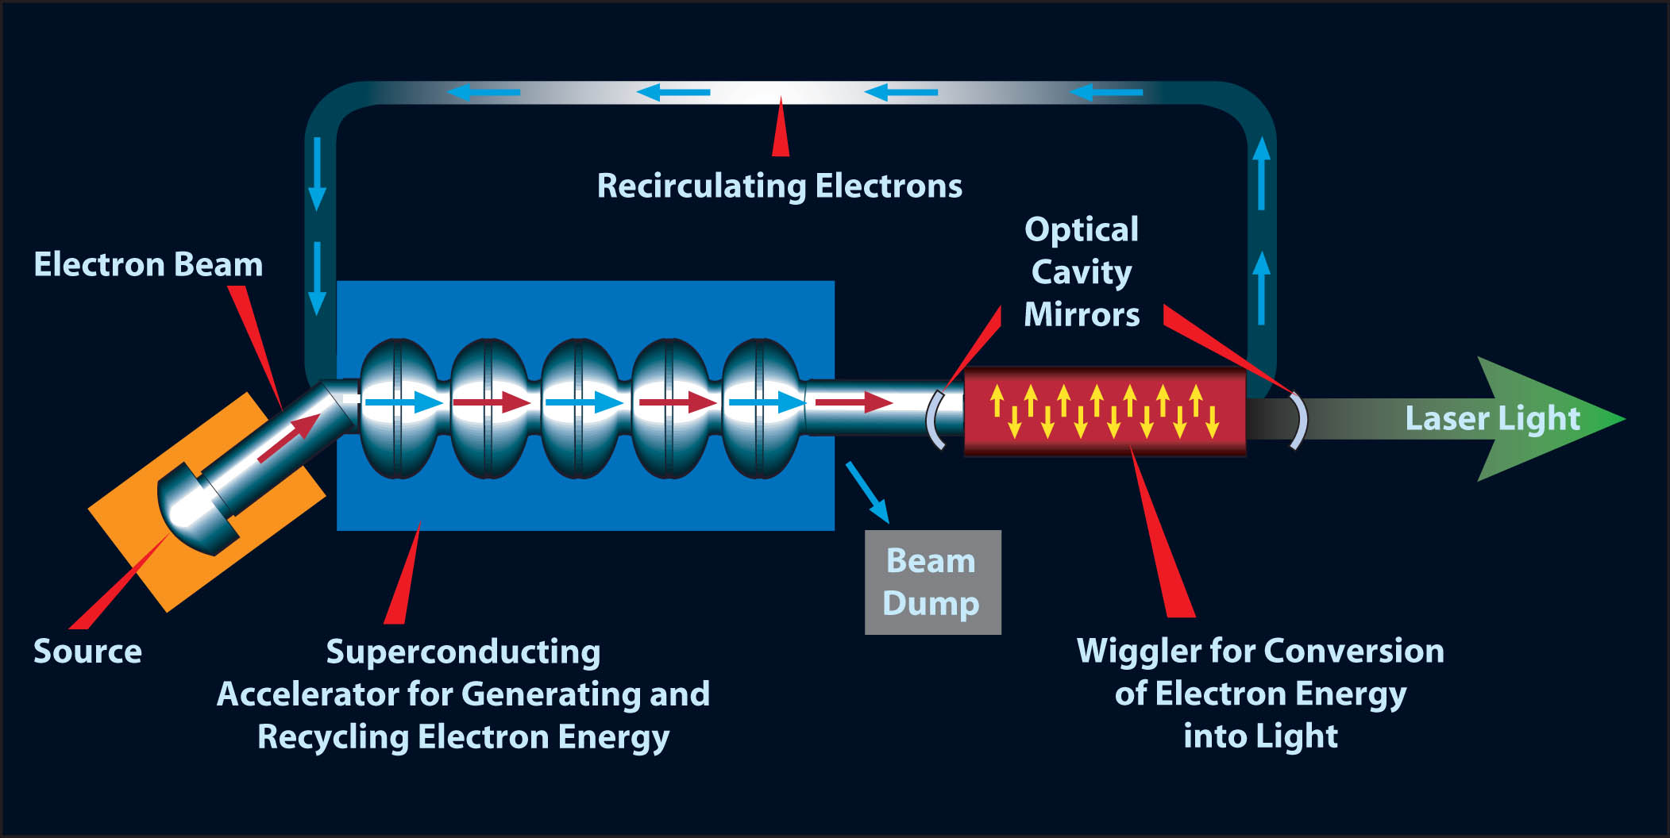
Free-Electron Laser (FEL)
With Energy-Recovery Linear Accelerator (ERL) design

Slide 10
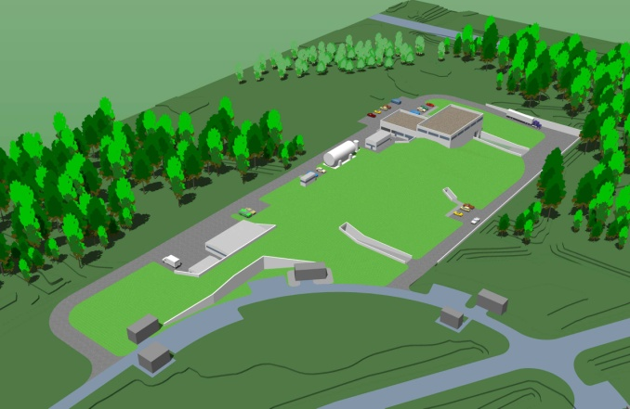
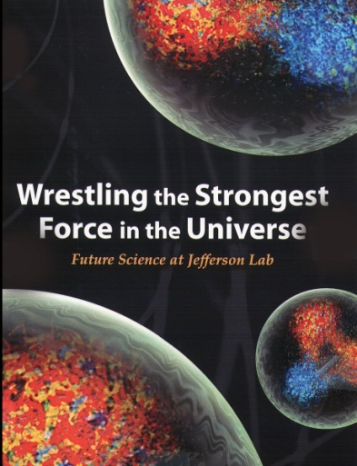
The Future
Jefferson Lab must upgrade its main
accelerator (CEBAF) and experimental
Areas in order to maintain the Lab’s world
scientific leadership for several decades.
A $310M federally funded project, the 12 GeV Upgrade is increasing our user community.
Artist’s concept of the planned Hall D – part of the 12 GeV Upgrade project.

Slide 11
The End
Questions?

